Slide 1

TUESDAY, SEPTEMBER 15, 2020 3:30 PM
Gamma Chapter Meeting
Ashland University –
What is Happening in 2020
Dr. Patricia Farrenkopf

Slide 2
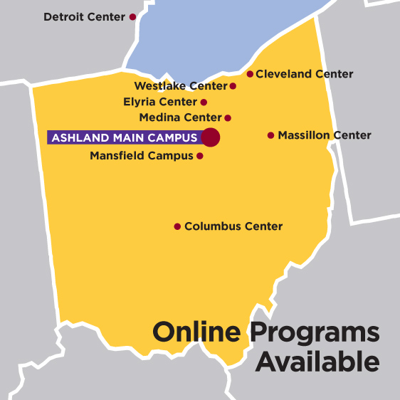
Ashland University Presence

Slide 3
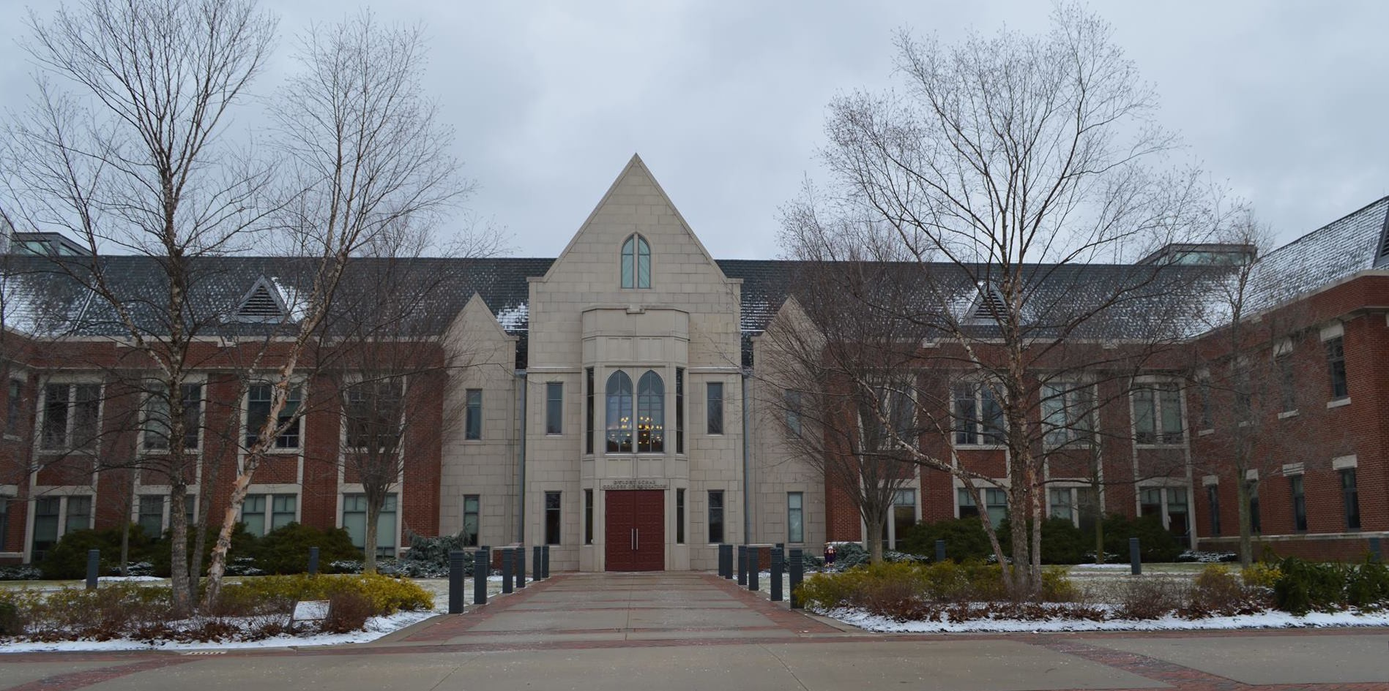
Ashland University
Dwight Schar College of Education

Slide 4

Founders Continuing Education

Slide 5
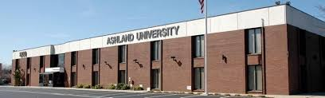
Ashland University
Columbus Center

Slide 6
Colleges of Ashland University
The College of Arts & Sciences
Richard E. & Sandra J. Dauch College of Business & Economics
Dwight Schar College of Education
Dwight Schar College of Nursing & Health
The Graduate School (Masters and Doctoral)
The Founders School of Continuing Education
The College of Online and Adult Studies
Evangelical Theological Seminary

Slide 7

Strategic Plan

Slide 8
My Ashland History
Over 25 years of serving as Adjunct Instructor
Fulltime Professional Instructor – Department of Doctoral Studies and Advanced Programs
since 2019
Faculty Course Designer for Talent Development and Educational Leadership

Slide 9
Courses Created and Taught
Gifted and the Gen Ed Teacher I and II
(Professional Development)
*******
Curriculum for the Gifted
Developing and Supervising Programs for the Gifted
(Gifted Endorsement on Teaching License)
*******
Theories of Instructional Leadership
Issues Impacting Student Achievement
Improving Instruction
The Visionary School Leader
Internship School Improvement Project
Emerging Issues Capstone
(Educational Leadership)

Slide 10

High Impact Grant Award Recipient
Moving the
Martin W. Essex School for the Gifted and TalentedTM
from Otterbein University
to
Ashland University

Slide 11
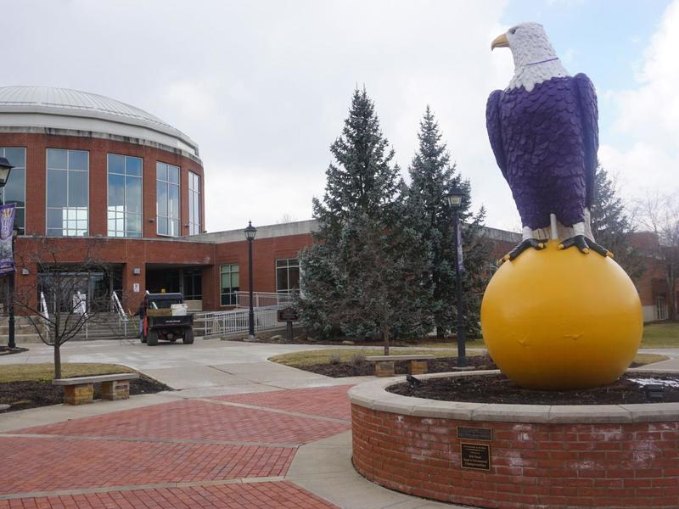
Questions?

